Slide 1
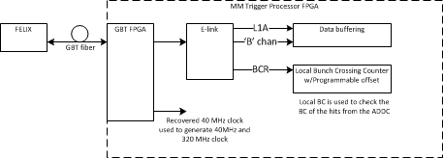
TTC Block Diagram

